Slide 1

Dr. Andrew Green, Director, Zinc Nutrient Initiative
2013 International Zinc and Zinc Oxide Industry Conference

Slide 2
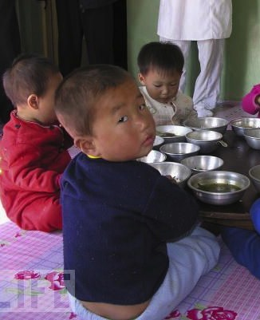
Zinc Deficiency is a Global Issue
2 BILLION
1.5 MILLION
800,000
450,000
People worldwide who don’t get enough zinc
Children who die each year from diarrhea
People at risk of dying each year from zinc deficiency
Children at risk of dying every year due to zinc deficiency

Slide 3
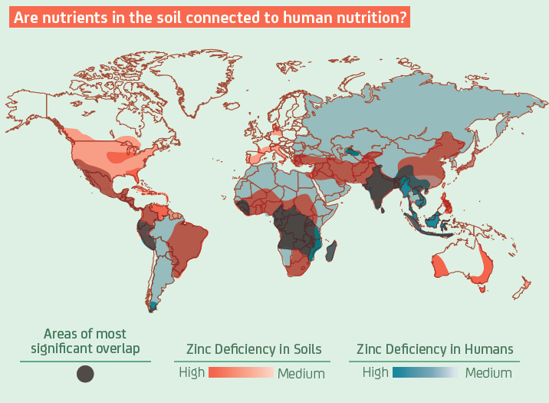
Zn Deficient Soils ➔ Zn Deficient Humans
Courtesy of Roots For Growth. www.rootsforgrowth.com

Slide 4

Copenhagen Consensus 2012
Eight leading economists agree that the number one solution to the world’s leading challenge is to bundle micronutrients—including zinc
Top 10 Investment Strategies:
Bundled micronutrient interventions to fight hunger and improve education
Expanding the Subsidy for Malaria Combination Treatment
Expanded Childhood Immunization Coverage
Deworming of Schoolchildren, to improve educational and health outcomes
Expanding Tuberculosis Treatment
R&D to Increase Yield Enhancements, to decrease hunger, fight biodiversity destruction, and lessen the effects of climate change
Investing in Effective Early Warning Systems to protect populations against natural disasters
Strengthening Surgical Capacity
Hepatitis B Immunization
Using Low‐Cost Drugs in the case of Acute Heart Attacks in poorer nations

Slide 5
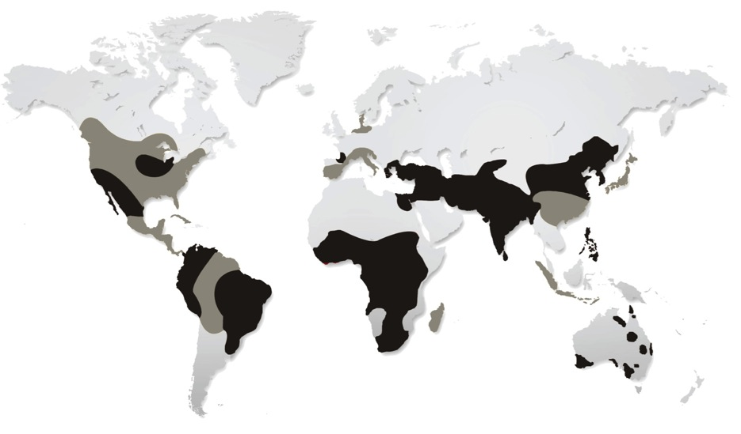
Zinc is Essential for Agriculture
Zinc deficiency…
Is the most common micronutrient deficiency
Occurs in 50% of the world’s agricultural soils
Will prevent crops from reaching their full potential even if their macronutrient needs are met
Agricultural production must increase by 70% by 2050

Slide 6
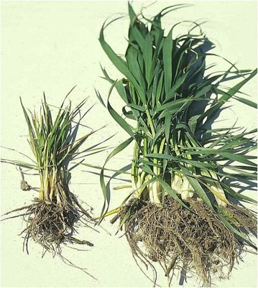
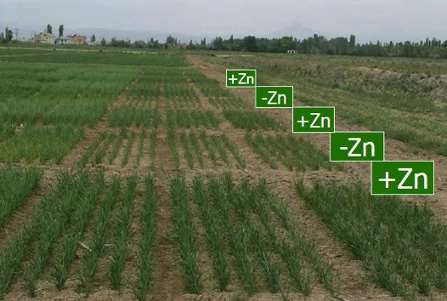
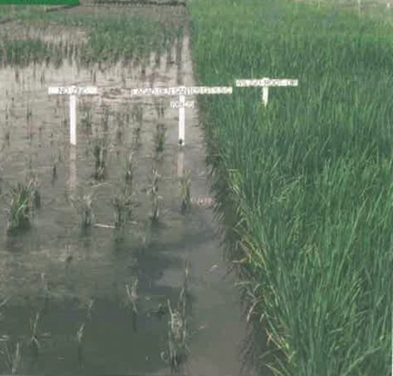
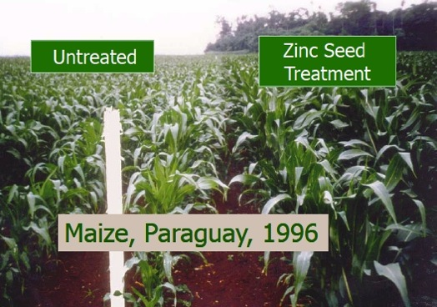
With Zinc….Without Zinc
Crops in Central Anatolia
Wheat plants
Corn crops in Paraguay
Rice Paddies in China

Slide 7
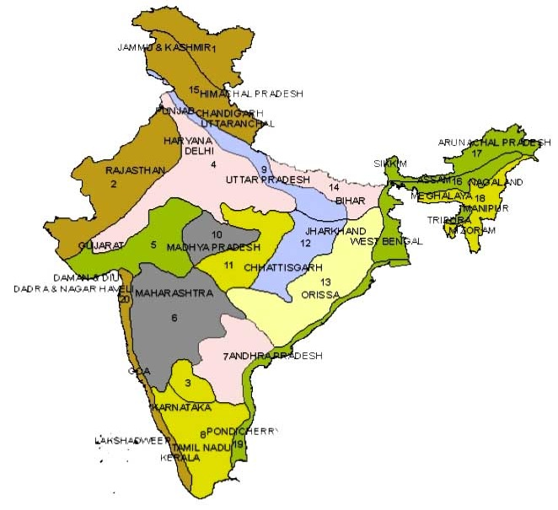
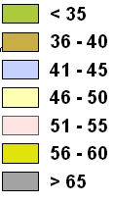
Zinc Deficiency in Soil: India
The average level of Zn deficiency in Indian soils is 50%.
That number is projected to increase to 63% by 2025.
26% of India’s population is at risk of zinc deficiency
% Zn deficiency in soil
M.V. Singh, IISS, Bhopal, 2000

Slide 8
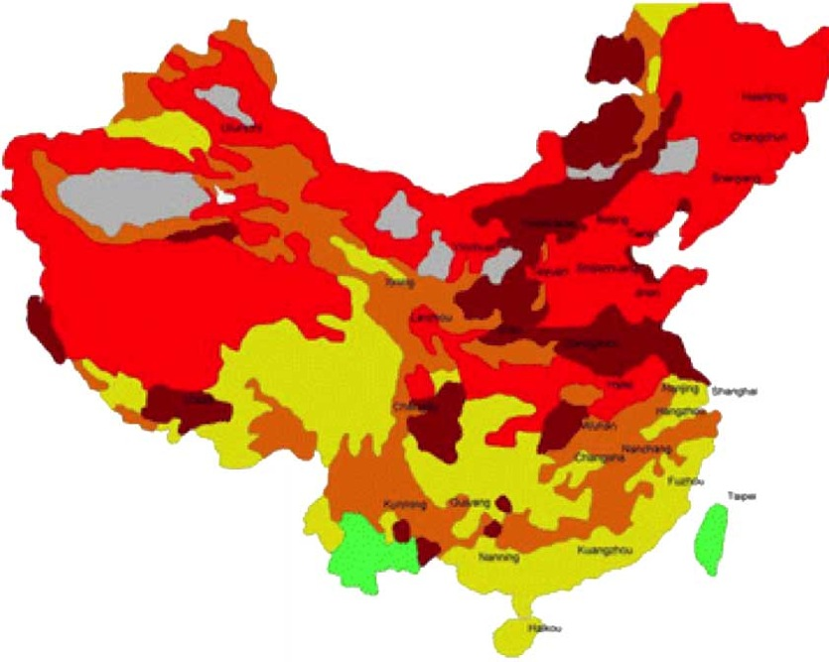
Zinc Deficiency in Soil: China
DTPA, plant available Zn in soil
 | < 0.5
 | 0.5 - 1.0
 | 1.1 - 2.0
 | 2.1 - 5.0
 | > 5.0
 | Not investigated
Almost half of the agricultural soils in China are zinc- deficient.
14% of China’s population is at risk of zinc deficiency
Yang XE, Chen WR, Feng Y. 2007. Improving human micronutrient nutrition through biofortification in the soil-plant system:
China as a case study.Environ Geochem Health.29(5):413-428.

Slide 9
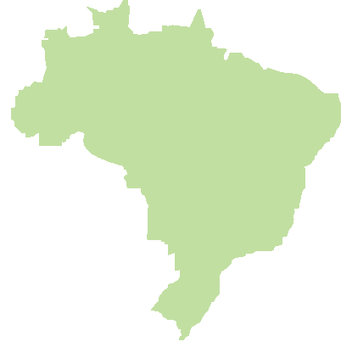
Zinc Deficiency in Soil: Brazil
Recent soil sampling studies revealed that 46% of soils in Brazil are at low levels of zinc availability and 43% are at medium levels.
A recent study on human health shows that 30 to 40% of the population in Brazil is at risk of zinc deficiency.
In the northeast (poorer) regions of Brazil, 50% of the population is at risk.
46% of soils
show low levels of
zinc availability

Slide 10
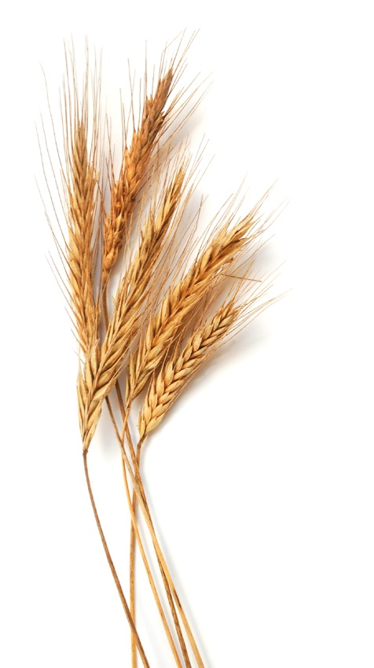
Zinc Nutrient Initiative
Objectives:
Improve crop yield
Improve nutritional value of crops
Improve human nutrition
Increase farmer’s incomes
Increase zinc fertilizer market

Slide 11
ZNI Strategy
Farmers
Fertilizer Companies
NGOs & Associations
IZA
Governments
Identification of key barriers/opportunities
Crop & demonstration trials
Education/Training
Conferences/Symposia
Policy changes
Success through partnerships
Policy
Education
Perceived Risk

Slide 12
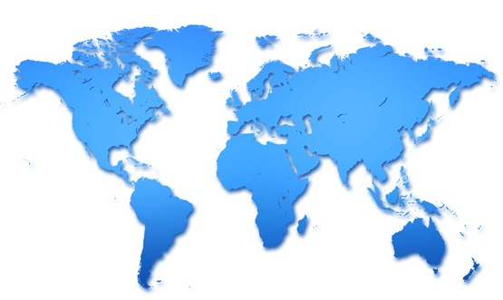





ZNI Offices
ZNI Crop Trials
Harvest Zinc Trials
ZNI China
Beijing
Ming
Xian Fan,
Director
ZNI USA
Durham, NC
Andrew
Green,
Director
Teri Kuhn,
Program
Coordinator
Canada
Kazakhstan
USA
Turkey
Pakistan
CHINA
Mexico
Bangladesh
Guatemala
INDIA
Laos
Thailand
ZNI India
New Delhi
Soumitra Das,
Director
ZNI Brazil
Sao Paulo
Joao Moraes,
Director
Zambia
BRAZIL
Malawi
Zimbabwe
Mozambique
Argentina
South Africa
Australia
China/India/Brazil ~53%

Slide 13

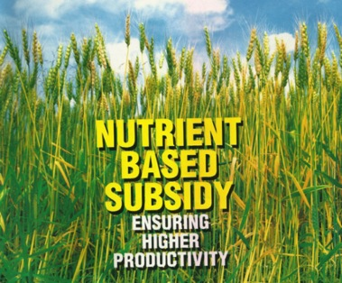
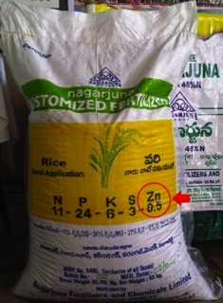
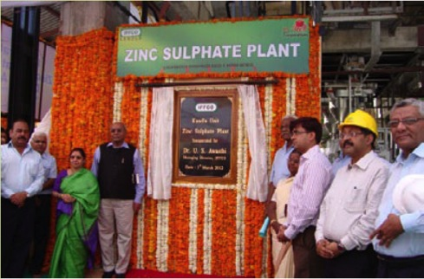
Developments in India
Zinc subsidy included in India’s NBSS in 2010
31 new zinc fertilizer grades in India
65% increase in Zn-fertilizer use in India
30,000 tonnes ZnSO₄ mono plant commissioned

Slide 14
Developments in India
preliminary increase
Source: FAI
Total market potential = 200,000 tonnes

Slide 15
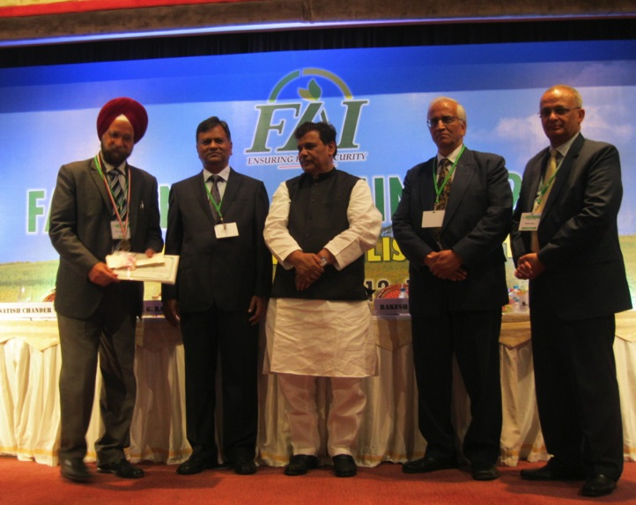
Developments in India
IZA-FAI Award 2012 “For Promoting the Use of Zinc in Indian Agriculture” Award winner – Dr. U.S. Sadana, PAU, Ludhiana, Punjab

Slide 16

India: Next Steps
Working with government to:
Increase subsidy for zinc in NBSS
Include “customized fertilizers” in NBSS
Use of zincated-urea product in India with IFFCO et al
epartment of Agriculture & Cooperation
Ministry of Agriculture
Government of India

Slide 17
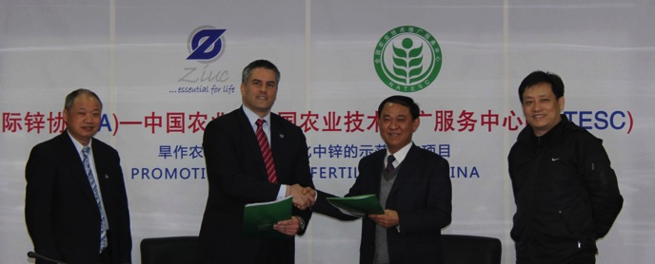
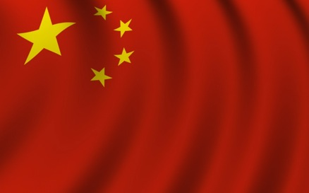
Developments in China
Early in 2012, China MOA issued national recommendation for zinc fertilizer in key crops.
Recommendation extended in mid-2012 for summer crops, specifically for rice and corn.
Recommendation for zinc now expanded to winter crops including wheat and potatoes

Slide 18
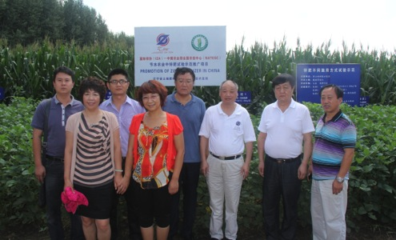
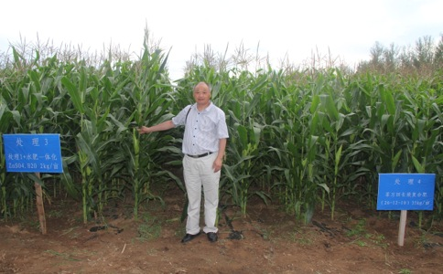
MOA Recommendation
Impact in China
Now includes all key staple crops: rice, corn, wheat, potatoes plus others
National recommendations distributed to 400,000 extension workers
When recommendation fully implemented, impact estimated at 300,000 tpy Zn

Slide 19



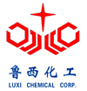
Developments in China
As result of ZNI China program, 6 new zinc Fertilizer Production Projects:
Sinofert
Zn-Enriched Urea
Kingenta
Zn-Containing NPK Fertilizer
Luxi
Zn-Enriched MAP
Zn-Enriched NPK
Weng-fu Group:
Zn-Enriched MAP
Zn-Containing NPK Fertilizer
Shenzhen Batian:
Zn-Enriched NPK
Total = > 5,000 tpy Zn metal
Notes:
Summary of new zincated fertilizer production as a direct result of IZA work.

Slide 20
Zn Consumption in Fertilizer Production in China
1000 tons
Source: IZA
Total market potential = 300,000 tonnes

Slide 21

China: Next Steps
Increase awareness and implementation of national recommendations for zinc
Joint program with MOA
Training sessions/awareness days
Communications
Expand recommendation to other key crops
Ministry of Agriculture
The People’s Republic of China

Slide 22

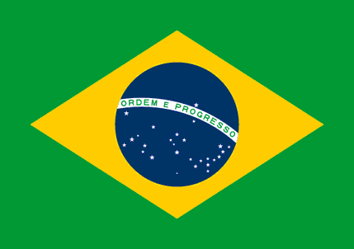
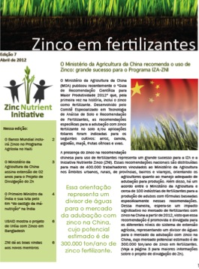
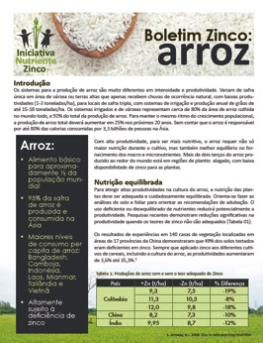
Developments in Brazil
MOU with EMBRAPA/Ministry of Agriculture
Working closely with ANDA and Abisolo
Micronutrients Symposia
2nd Brazilian Conference on Fertilizers
Zinc Forum held with key stake-holders

Slide 23

Brazil: Next Steps
Implement objectives from Zinc Forum
Develop map of zinc deficiency in Brazil
Develop fact sheets on zinc impact in main Brazilian crops
Review of Brazilian law for evaluation of zinc content and availability in fertilizers
Get recommendation from Embrapa et al
Work with crop co-ops to recommend and implement use of zinc fertilizer

Slide 24




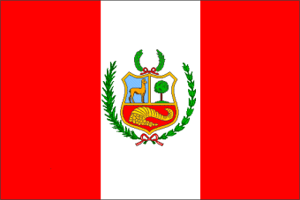



Other Activities
Collaborating with ILZSG and Agricultural Institutions in Africa on maize crops in Malawi
Working in Mexico with INIFAP on zinc in maize crops
Project in Peru with International Potato Institute
IFDC Partnership in Bangladesh to test & scale-up use of new Zn core-urea technology

Slide 25
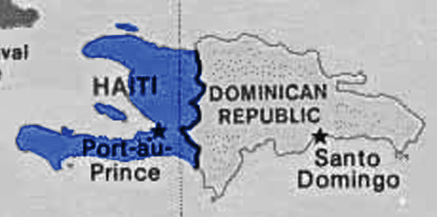

Other Activities
World Bank including zinc into their agricultural program in Haiti following meetings with IZA
New goal is to integrate zinc into other country agricultural programs as well, (e.g., Asia)
IZA participating on World Bank’s nutrition panel discussing “How Agriculture Can Solve the Nutrition Crisis”
“We are inspired by the zinc story”
~ World Bank

Slide 26
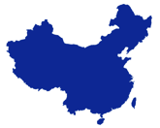
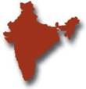

Market Potential
China… 300,000 tpy Zn
India… 200,000 tpy Zn
Brazil…. 60,000 tpy Zn
Program already having an impact in terms of market and zinc image

Slide 27


Financial Sector Taking
Notice of ZNI
China International Capital Corporation Ltd., (CICC) published extensive report on zinc fertilizer market, estimating the potential markets:
China: 350kt to 500kt
Global: 590kt to 920kt
Exclusive to Zinc Investing News: Zinc to Play Role in Agricultural Boom
“In the story of exploding global agricultural demand, zinc’s role has not been a prominent one. But now that it is emerging from the shadows cast by potash, phosphate and nitrogen fertilizers, zinc’s role as a micronutrient could turn out to be critical and lucrative.”

Slide 28











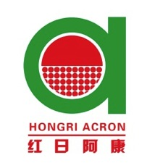












ZNI Affiliate Members
Notes:
Comments:
Very strong industry support.
Funding from affiliates is offsetting ZNI project costs.

Slide 29
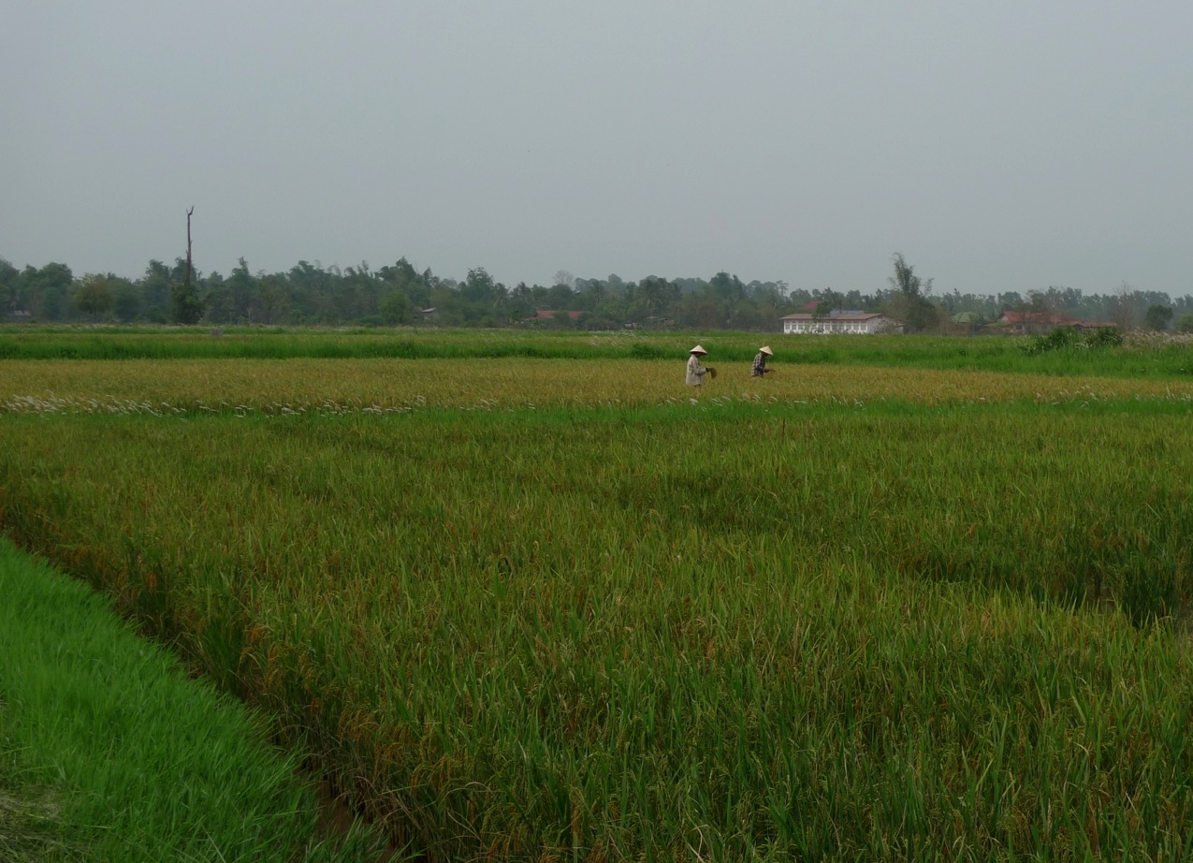
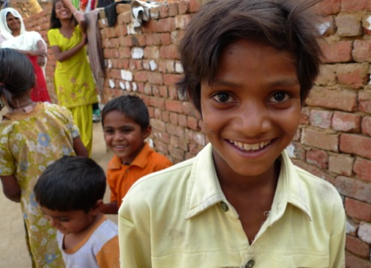
ZNI Program Summary
IZA’s ZNI program has contributed to:
Enhanced market growth for zinc
Solving two of the world’s biggest challenges:
Food security
Human health

Slide 30




For More Information:
agreen@zinc.org | www.zinc.org
Zinc Nutrient Initiative @ZincForCrops Zinc Nutrient Initiative

